Slide 1
Perfect Toys
KPI and charts - Daily report

Slide 2
Situation/Problem
Presenting some KPI’s and charts on different areas of the Business:
Sales;
Finances;
Logistics;
Human Resources.

Slide 3
Solution
Daily report with automation with SQL/Python/Google Colab;

Slide 4
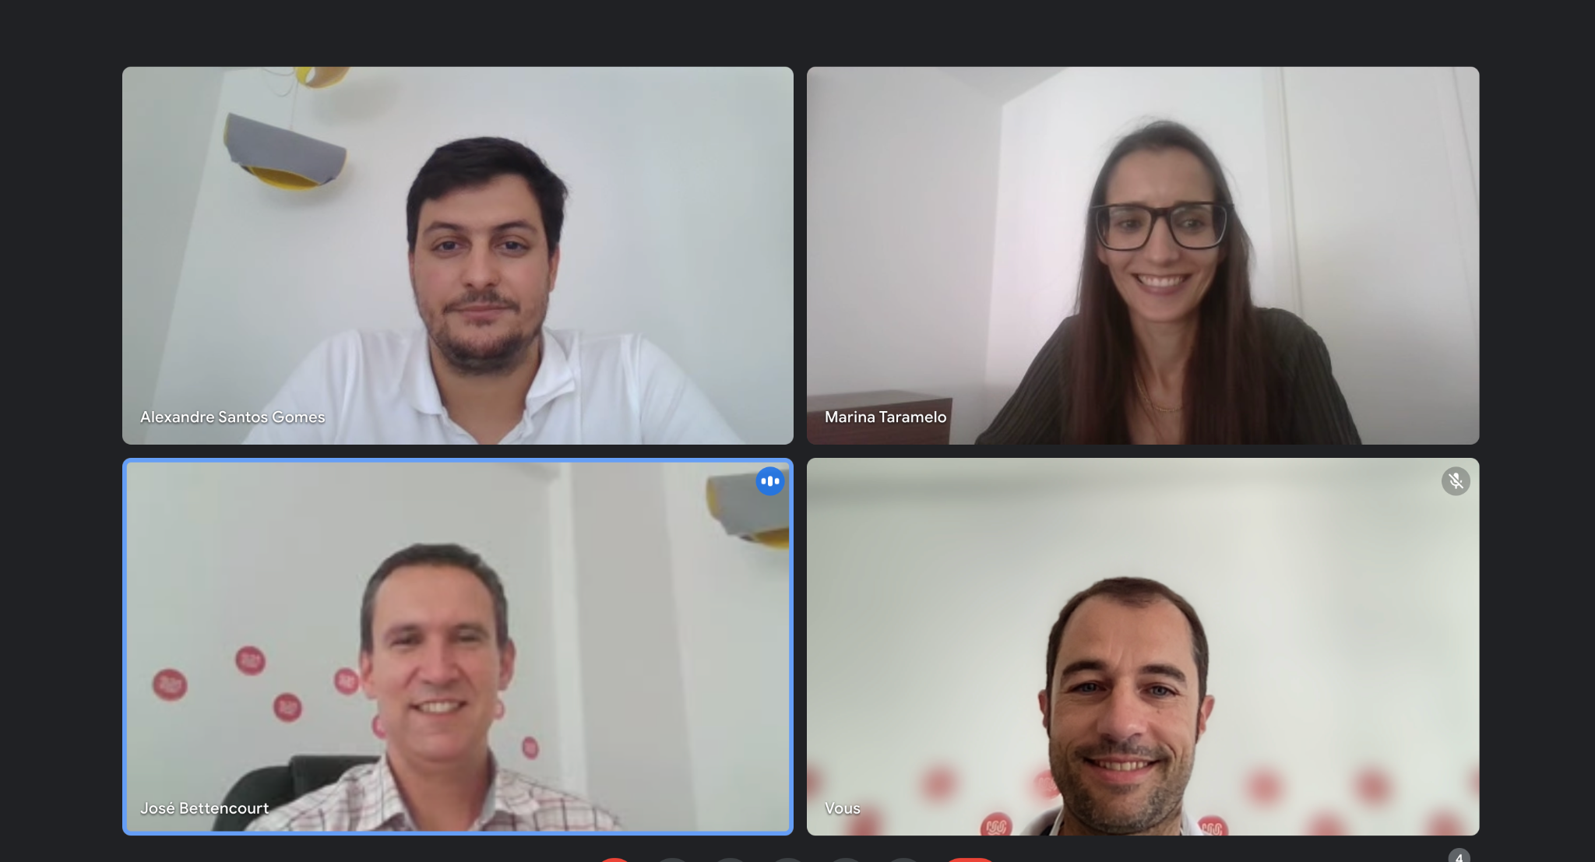
The team
Add the picture

Slide 5
Let´s check the report!

